Slide 1
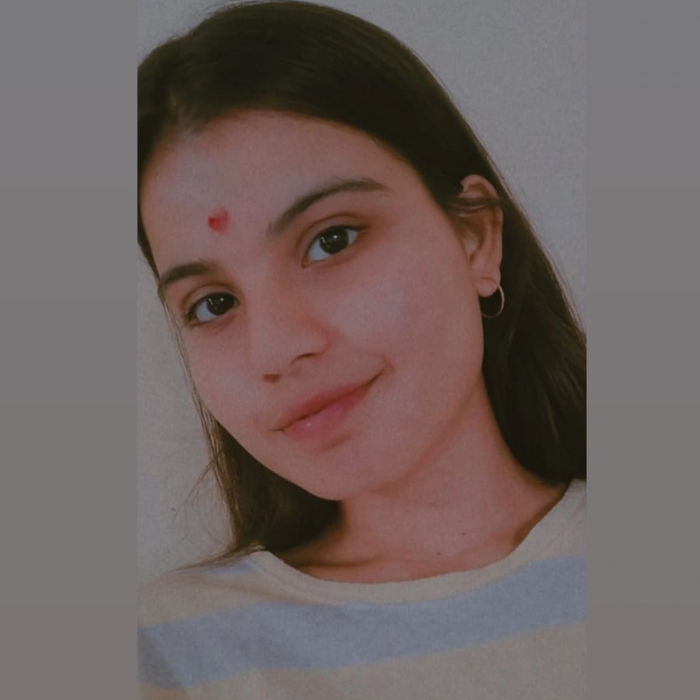

KRATI MISHRA
Bachelor of Computer Application : 2019 - 2022
Associate/Software Associate
Skills
C# | Basics, OOPS, Exception Handling, Arrays, Collection and Generics, Delegates and Events, File IO and Serialization.
.NET | ADO.NET, ASP.NET with MVC and WEB API, Entity Framework
Angular | Components, Services, Modules, Routing, Forms & Validation
ADO.NET | Basics Architecture
Database | Microsoft SQL Server
Tools | GIT, SSMS, Visual Studio, Visual Studio Code
Cloud | Microsoft Azure AZ-900
UI Technology | HTML5, CSS JavaScript & Angular
Add on Skills | Communication skills Team Management
Mumbai
krati.a.mishra@capgemini.com
+91 9889576717
A3
SHOPPING CART SYSTEM:
Case Study on Shopping Cart System using ASP.NET Core with Entity Framework ,Web API and SQL Server Management Studio, User Interface created with HTML5, CSS3, JavaScript and Angular14. Backend with WEB API SQL-Server and fronted with Angular. It is a Website for Seller and Customers. Customers can buy products online and Seller can add, update and delete Products.
Degreed :
Successfully completed the degreed training in Git, HTML, CSS, SQL, C#, .NET Core, Angular
Technologies used:
ANGULAR
ASP.NET Core
Microsoft SQL Server
Full Stack Developer
Hands on experience on C#,ADO.NET,SQL Server , ASP.NET MVC5 with WEBAPI.
Hands on experience in developing web pages using HTML5, CSS3, Object Oriented Java script, ES6
Knowledge on creating Single Page Web Applications using Angular
Having Knowledge on Git and GitHub.
Attended training on ITransform-Microsoft.NET
Check out my work on GitHub
GitHub Link

